Slide 1
Hardware and Software Interfaces, CSCI 3511 Final Project Title:
Arduino Controlled Piano
BY: Susan Lee, SID: 105986679
Amanuel Chukala, SID: 109193518
Robert Armbrust, SID: 100345972
Instructor: Liang He, Ph.D.
Submission Date : 09/18/2018

Slide 2
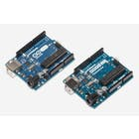
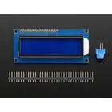
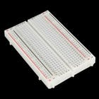
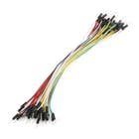
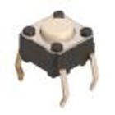
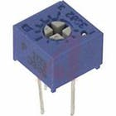
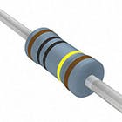
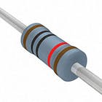
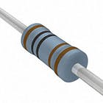
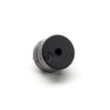
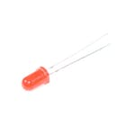
Components and Supplies
Arduino UNO & Genuino UNO
Adafruit Standard LCD – 16x2 White on blue
Jumper wires
Breadboard
Push Button x8
Single Turn Potentiometer – 10k ohms
Resistor
220 ohm x4
560 ohm
4.7k ohm
Buzzer
LED
1M ohm
10k ohm x3
1k ohm

Slide 3
About the Project
(7/8) press button represents a piano key
The resistors (1M, 10k, 4.7K, 1K, 560, and 220) change the pitch
Last press button (8/8) grounds and connects all 7 switches using a 10k ohm resistor
LED is used to indicate “menu mode”, LED lights on when menu is on
Program begins with LED off and keyboard active
Once in menu, LED will be turned on and piano keys disabled
Double click to restart menu

Slide 4
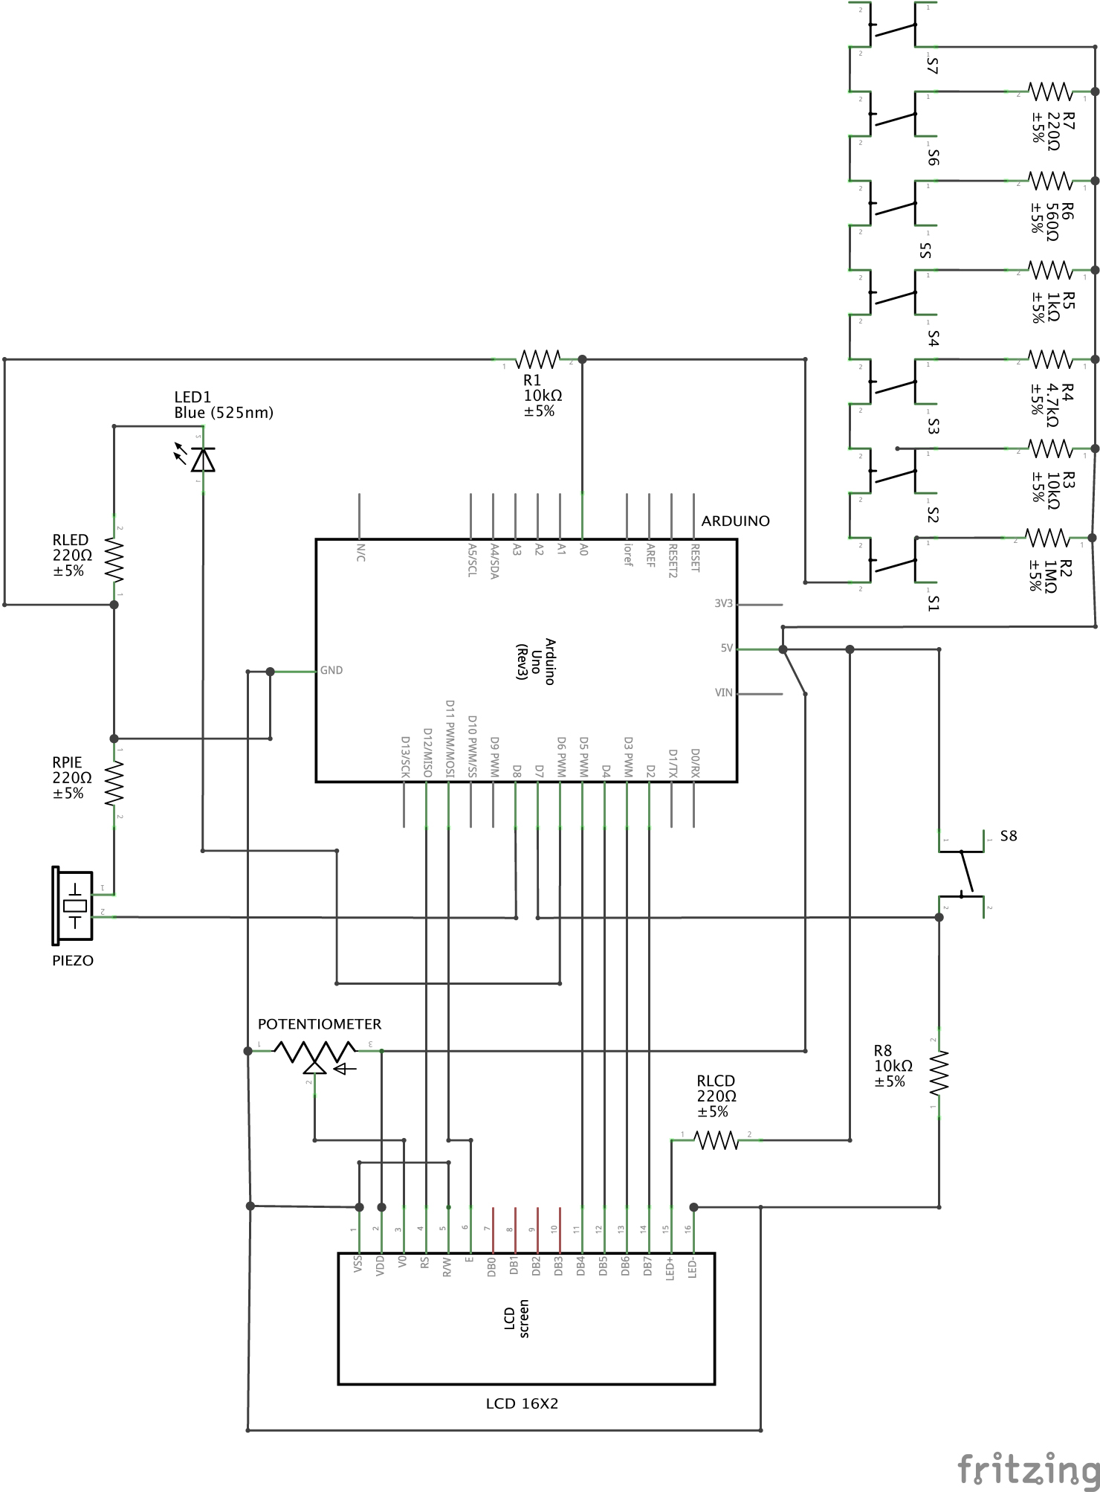
Schematics

Slide 5
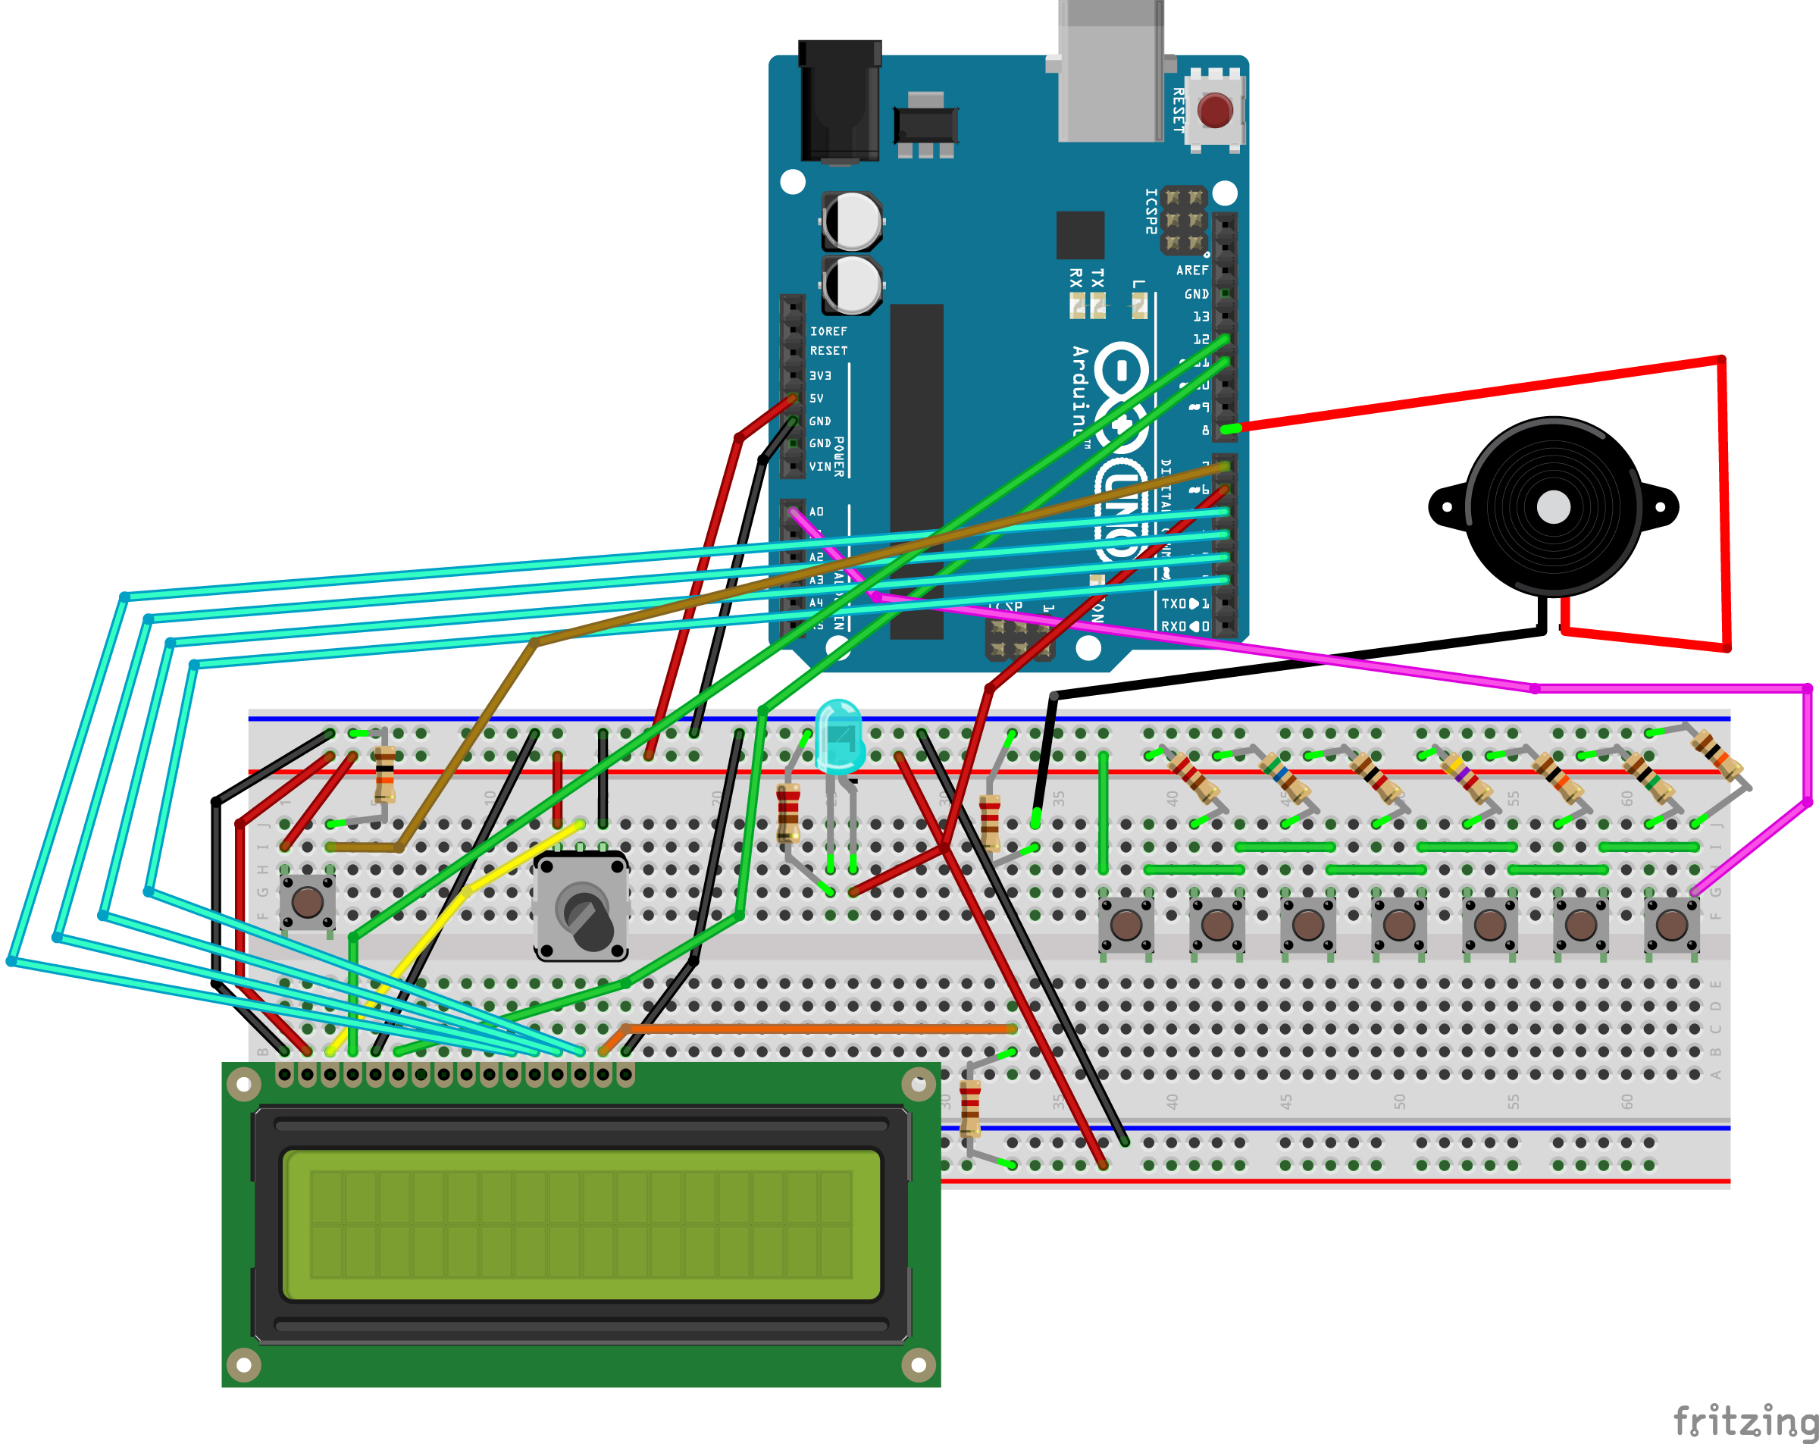
Circuit Diagram

Slide 6
Source:
All the pictures credit goes to Lindsay Fox, an author on Arduino Project Hub, where you will find her awesome Arduino projects on the following website:
https://create.arduino.cc/projecthub/lindsi8784/electronic-piano-keyboard-with-preset-songs-74ee7c?ref=tag&ref_id=piano&offset=0
Even though we have used her work as an initial idea, there will be a completely different source code and some added features – hopefully ☺

